Slide 1
Time spent amongst trees is never wasted time.
– Katrina Mayer
Lecture 17 – Binary Tree Traversals and Related Properties
CST370 – Design & Analysis of Algorithms
Dr. Byun
Computer Science

Slide 2
Lecture Objectives
After completion of this lecture, you will be able to
  conduct binary tree traverse algorithms using three different approaches (= preorder, inorder, postorder traversals).
  compute the height of a binary tree using a divide-and-conquer technique.

Slide 3
Chapter 5: Divide-and-Conquer
5.1 Mergesort
5.2 Quicksort
5.3 Binary Tree Traversals and Related Properties
5.4 Multiplication of Large Integers and Strassen’s Matrix Multiplication
5.5 The Closest-Pair and Convex-Hull Problems by Divide-and-Conquer

Slide 4
Binary Tree
A binary tree is a divide-and-conquer ready data structure.
  This means that you can use divide-and-conquer techniques to solve many problems in the binary tree.
  In this lesson, you will use the divide-and –conquer techniques to solve two problems (= tree traversal and tree height).

Slide 5
Binary Tree Traversals
One classic problem with binary trees is to systematically visit each node.
  There are three binary tree traversals called inorder, preorder, and postorder.
Watch the following video to understand the basic operation of tree traversals.
  http://y2u.be/gm8DUJJhmY4

Slide 6
Inorder Traversal – Pseudocode
Algorithm Inorder(T)
if (T != empty)
{
Inorder (T_{left})
print (root of T)
Inorder (T_{right})
}
Time complexity: theta(n)
  // n is the number of nodes.

Slide 7
Exercise

Slide 8
Solution

Slide 9
Tree Traversal Implementation in C++
https://repl.it/@YBYUN/InorderTraversal
  The program conducts the inorder traversal to the following binary tree.
  5
  / \
  3 4
  / \
  1 2

Slide 10
Source Code (1 of 3)
struct Node
{
// Data part for a node.
int data;
Node* left;
Node* right;
// Constructor for a new node.
Node(int d)
{
data = d;
left = nullptr;
right = nullptr;
}
};

Slide 11
Source Code (2 of 3)
Node* mkTree(int data, Node* left, Node* right) {
Node* root = new Node(data);
root->left = left;
root->right = right;
return root;
}
int main() {
Node* n1 = new Node(1);
Node* n2 = new Node(2);
Node* n3 = mkTree(3, n1, n2);
Node* n4 = new Node(4);
Node* n5 = mkTree(5, n3, n4);
inorder(n5);
}

Slide 12
Source Code (3 of 3)
void inorder(Node* root)
{
if (root != nullptr) // Or simply "if (root)"
{
inorder(root->left);
cout << root->data << endl;
inorder(root->right);
}
}

Slide 13
Exercise

Slide 14
Height of a Binary Tree
The height of the binary tree is the length of the longest path from the root to the leaf node in the tree.
Example
A
A
B
C
B
C
D
Tree height = 1
Tree height = 2

Slide 15
Height of a Binary Tree
Note that the height of a binary tree with only one node (= root node) is zero.
Also, the height of an empty tree is -1.
  A height of -1 sounds like a meaningless number.
  However, to solve the problem of a binary tree’s height, we should define the height of the empty binary tree.
  It’s the basic case of this recursive problem.

Slide 16
Height of a Binary Tree – Basic Idea

Slide 17
Height of a Binary Tree
Let's say we have a binary tree T with the left tree T_{L} and the right tree T_{R}, as shown below.
  Then, we can say that the height of the binary tree T is one longer than the maximum height of T_{L} and T_{R}.
For more information, watch the following video.
  http://y2u.be/_pnqMz5nrRs
root
T_{L}
T_{R}

Slide 18
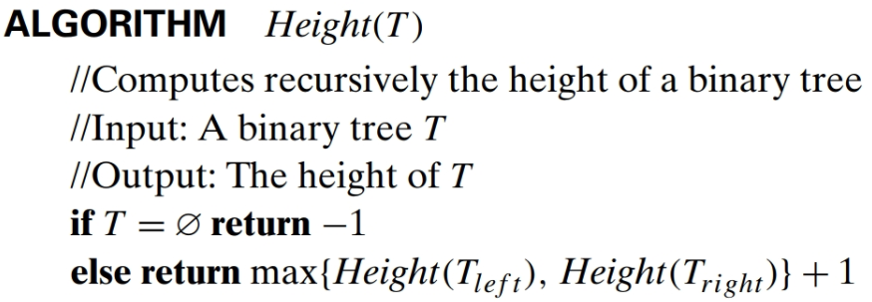
Height of a Binary Tree – Pseudocode
Time complexity

Slide 19
Puzzle – Making Coin Pairs
There are 8 coins placed in a row.
  The goal is to form 4 pairs of them by a sequence of moves (or jumps).
  On each move a single coin can jump right or left over two coins adjacent to it (i.e., over either two single coins or one previously formed pair), to land on the next single coin; no triples are allowed.
  Any empty space between adjacent coins is ignored.

Slide 20
Solution

Slide 21
Puzzle – Making Coin Pairs
Now, there are 10 coins placed in a row.
  The goal is to form 5 pairs of them by a sequence of moves (or jumps) as the previous puzzle.
  Hint: Don’t try from the scratch. Think if you could use the solution of the previous puzzle.

Slide 22
Binary Search Tree Implementation in C++
https://repl.it/@YBYUN/BST
  The program conducts the inorder traversal and search() function to the following binary search tree.
  10
  / \
  5 15
  / \ /
  2 7 12

Slide 23
Exercise
Present an idea for a function which checks if a tree is BST or not.

